Slide 1

Heap Bubble Shell Sort
Topic 2 - Demonstration of sorting algorithms on array
Team 4
Nguyen Khanh Linh 20194789
Le Minh Hieu 20184257
Hoang Dai Long 20194792

Slide 2
Problem Statement
Why demonstration of sorting on arrays?
Array is the most basic and widely used data structure
Sorting is the common subroutine for other techniques such as binary search, counting inversions, …
Help visualize how each algorithm works

Slide 3
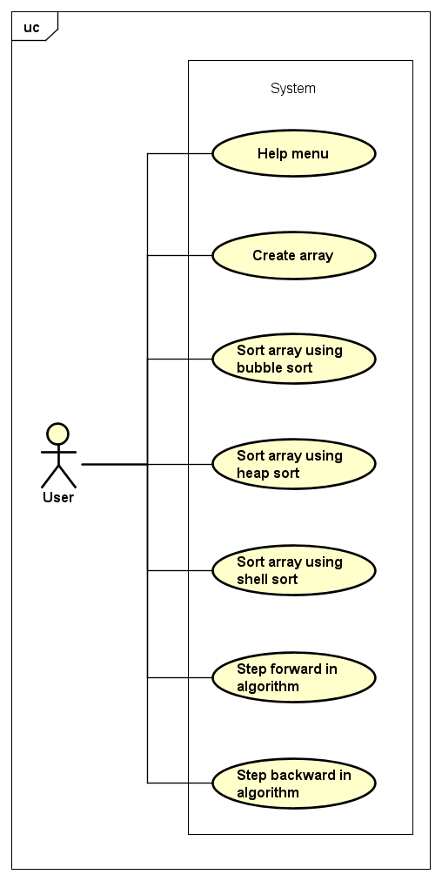
Use Case Diagram

Slide 4
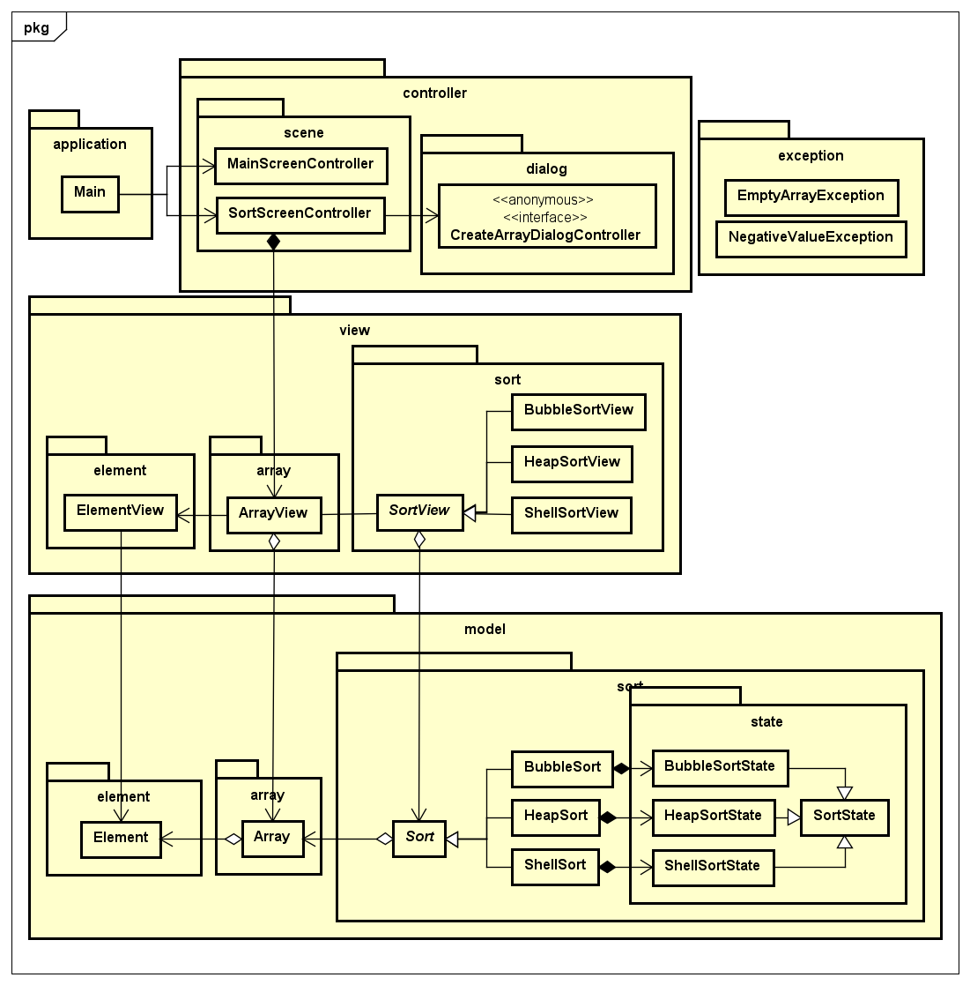
General
Class
Diagram

Slide 5
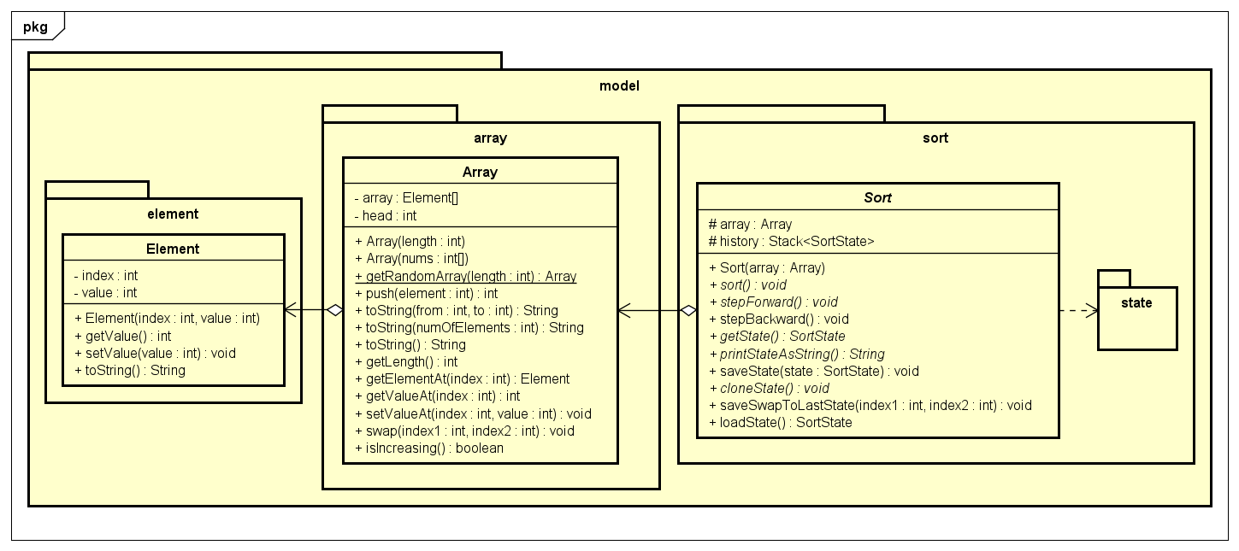
Class Diagram Model

Slide 6
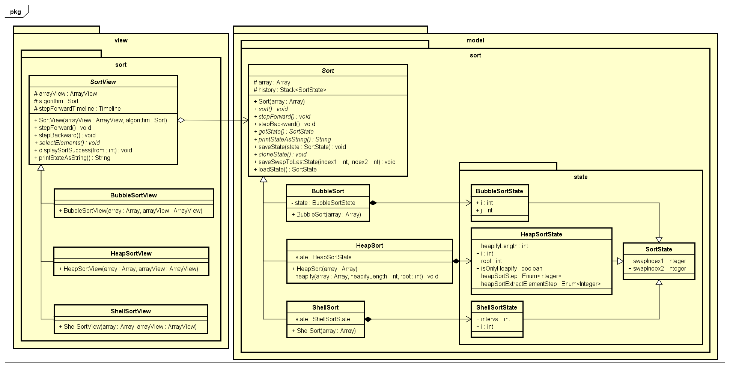
Class Diagram Sort

Slide 7
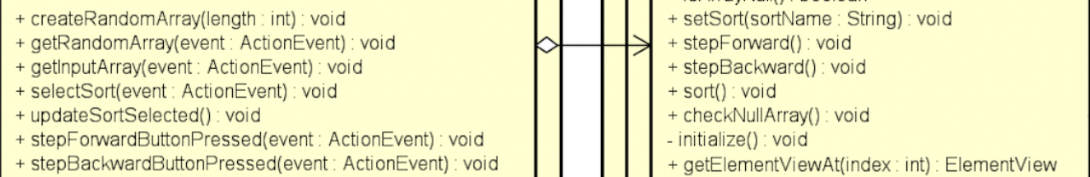
OOP Techniques Used
Encapsulation:
Array class has private array of Elements. So, other classes can only manipulate the array by calling its public methods (get length, swap,…)
Abstraction:
SortScreenController can call StepForward, StepBackward methods from ArrayView without knowing how they are implemented underneath

Slide 8
OOP Techniques Used
Aggregation:
SortScreenController contains ArrayView
ArrayView contains ElementViews, SortViews for each algorithm, and an Array as its model
Sort has a reference to Array, to perform sorting
SortView has a reference to ArrayView for changing ElementView’s colors
Composition:
BubbleSortState belongs to BubbleSort, is created by BubbleSort, and cannot exist without BubbleSort (same with other sort algos…)

Slide 9
OOP Techniques Used
Inheritance:
SortView and its three ways to select elements
Sort and its three algorithms for sorting
SortState and its three classes for storing algorithm’s state
Polymorphism:
BubbleSortView passes a BubbleSort object to its constructor that requires type Sort by upcasting
Later, to retrieve state, BubbleSortView gets SortState by downcasting it to BubbleSortState

Slide 10
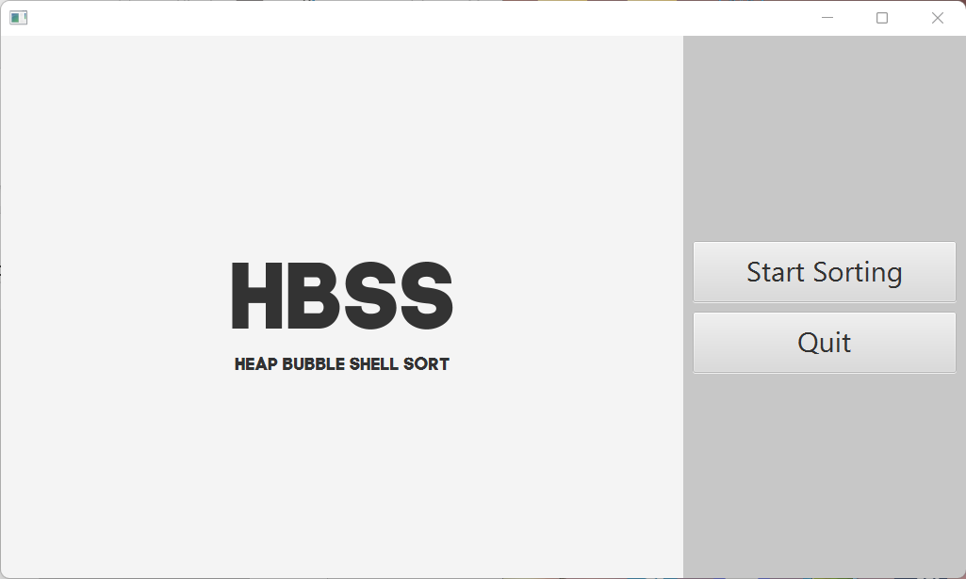
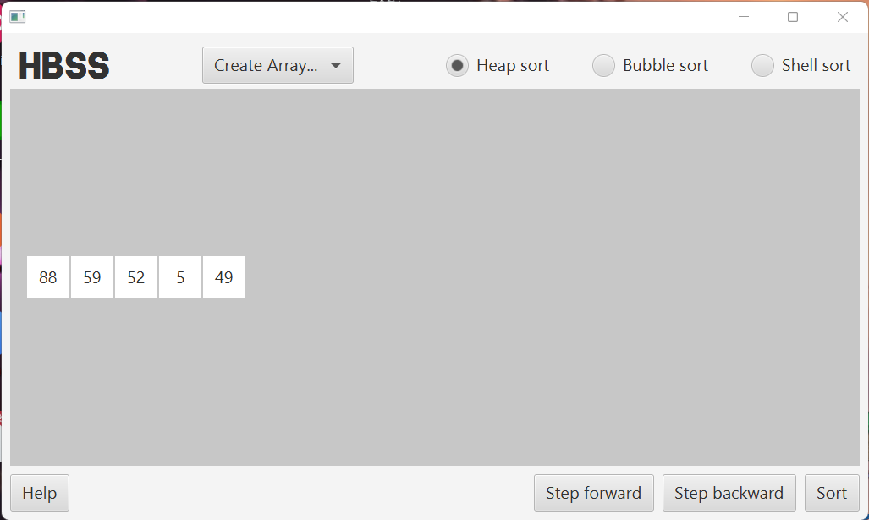
Demonstration Video
https://www.youtube.com/watch?v=6EHv3jX2mwM
MainScreen.fxml
SortScreen.fxml

Slide 11
Thank you!

